Slide 1

CS4157
Software Quality
Notes:
CS5707 Software Development Paradigms
John Dawson
CS5707 Software Development Paradigms
John Dawson
CS5707 Software Development Paradigms
John Dawson

Slide 2
Last Week
Guest Lecture: Medi-SPICE
Introduction to Project Management
Notes:
CS5707 Software Development Paradigms
John Dawson
CS5707 Software Development Paradigms
John Dawson
CS5707 Software Development Paradigms
John Dawson

Slide 3
Lecture Outline: Week 5 – 20th Feb
Introduction to Software Development Paradigms
Paradigms: A framework and concepts
Paradigms: History and types
Types of Information System Development
Notes:
CS5707 Software Development Paradigms
John Dawson
CS5707 Software Development Paradigms
John Dawson
CS5707 Software Development Paradigms
John Dawson

Slide 4
What is a Paradigm?
What is a paradigm? A set of assumptions, concepts, values, and practices that constitutes a way of viewing reality for the community that shares them, especially in an intellectual discipline (Dictionary)
Examples (of software development paradigms): Waterfall Model, Structured Programming, Prototyping, Iterative, SSADM, Rational Unified Process, eXtreme Programming, SCRUM etc.
Notes:
CS5707 Software Development Paradigms
John Dawson
CS5707 Software Development Paradigms
John Dawson
CS5707 Software Development Paradigms
John Dawson

Slide 5
Paradigms / Quality - Terminology
Paradigms
Methodology
Method
Technique
⇔
⇔
⇔
⇔
Quality
Process Models
Process
Practice

Slide 6
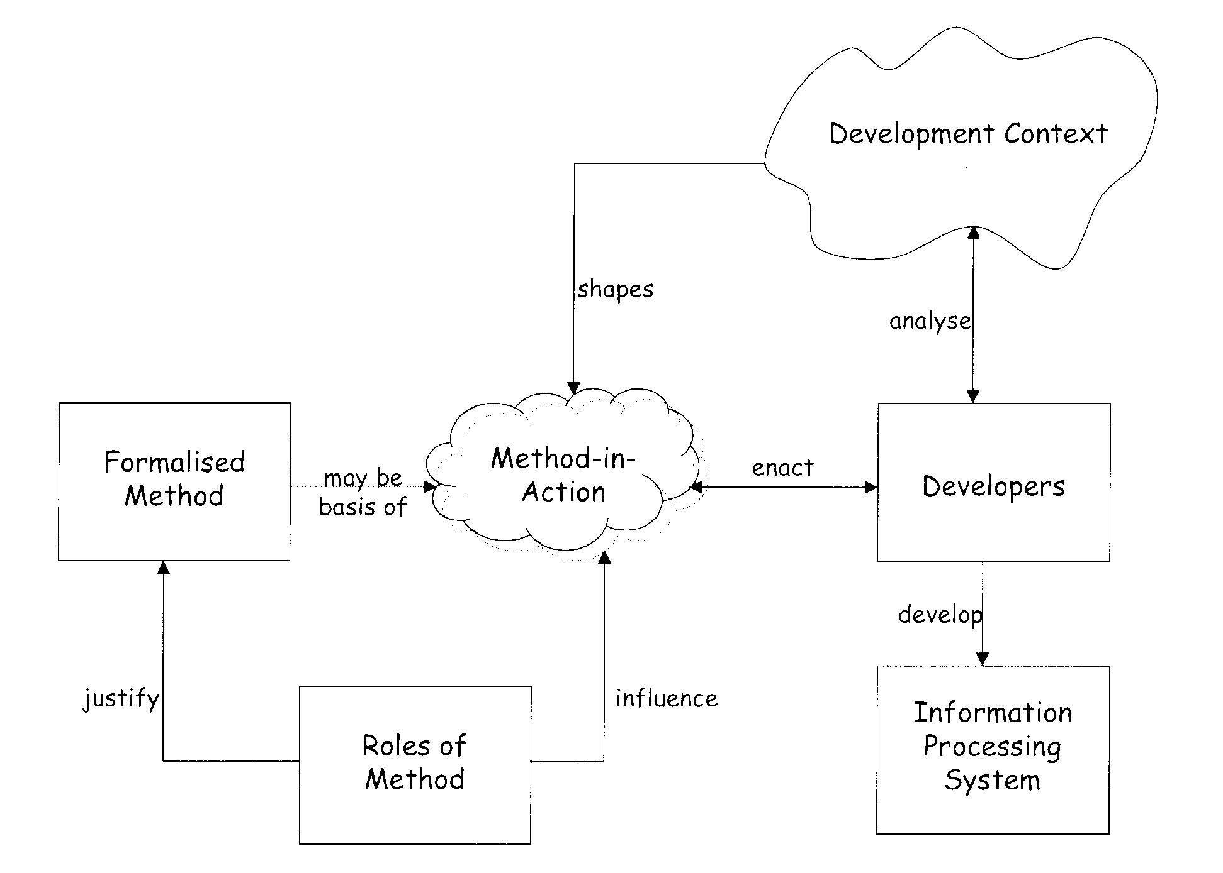
A Framework for Software Development
Notes:
Note that each “box” in this diagram represents a different type of object, some better defined than others
Developers: People
Information Processing System: Artefact, also culture of use
Formalised Method: Concepts, usually documents
Roles of Method: Concept, probably undocumented
Development Context: Various: buildings, infrastructure, culture
Method-in-Action: Description of “reality”
CS5707 Software Development Paradigms
John Dawson

Slide 7
A Framework for Software Development
Remember: “All models are wrong, but some are useful”
The FRS model, see Readings, is (hopefully) a useful way of thinking about diverse types of information system development
Notes:
Note that each “box” in this diagram represents a different type of object, some better defined than others
Developers: People
Information Processing System: Artefact, also culture of use
Formalised Method: Concepts, usually documents
Roles of Method: Concept, probably undocumented
Development Context: Various: buildings, infrastructure, culture
Method-in-Action: Description of “reality”
CS5707 Software Development Paradigms
John Dawson

Slide 8
Paradigms: More Terminology
Information System: A system which stores, processes and delivers information relevant to an organisation / society in such a way that the information is accessible and useful ... and which may or may not involve the use of computer systems
Method: Specific ways of approaching the various tasks involved in IS development
Method-ology: Comparative and critical study of methods in general
Techniques: e.g. Flow Charts, Data Flow Diagrams, Entity Relationship Diagrams, Use Cases etc.
Tools: An instrument, often itself software, for performing a technique e.g. Editors, IDEs, Eclipse, CAD, RUP etc.
Developer: practitioner (person / human) who develops an IS; includes traditional roles like analyst, designer, programmer etc, also other stakeholders: users, managers, testers, integrators
Notes:
CS5707 Software Development Paradigms
John Dawson

Slide 9
Framework Components: Information System
The artefact being developed, but not just technical: also social / cultural components
Families of systems, can categorise by:
  Purpose: Information, Education, Entertainment, Communication etc.
  Complexity: can be used a) “out of the box” b) some configuration c) major implementation project
Evolution: new system (unsolved problem) based on earlier systems – (solved) problems e.g.
  In the early years, development of time-sharing systems (multi-tasking) allowed better use of scarce computer resources, allowing faster development
  Airline (direct) booking only possible with the evolution of the Internet, which includes (for example) encryption ...
  ... all e-commerce is utterly dependent on encryption
Notes:
Political problems can cause “flawless” software systems to fail
Information System is both shaped by and shapes its context
CS5707 Software Development Paradigms
John Dawson

Slide 10
Framework Components: Formalised Method
Traditionally, the focus of research and management concern
Popular examples include SSADM: Structured Systems Analysis and Design Method, DSDM: Dynamic Systems Development Method
Exist either as manuals or software tools like CASE: Computer Assisted Software Engineering, RUP: Rational Unified Process
Not the cure-all once hoped for
Notes:
Key point: Formalised Method is not Method-in-Action
CS5707 Software Development Paradigms
John Dawson

Slide 11
Framework Components: Method-in-Action
Formal methods never applied completely or as intended
Different developers apply the same method in different ways on the same project
The same developer will apply the same method in different ways on different projects
Hence: the method-in-action is
  Uniquely enacted by the developer, also
  Shaped by the development context and
  Influenced by roles of method
Notes:
CS5707 Software Development Paradigms
John Dawson

Slide 12
Framework Components: Roles of Method
Twofold aspect: Rational Roles & Political Roles
Rational Roles of methods
  Decomposition: reductionist subdivision of process
  Division of labour: project management, systems analyst, programmer, tester etc.
  Application of techniques: design review, prototype
  Benefits: Standardisation, predictability, improved productivity
Political Roles of methods
  Comfort factor: “We’re using the proper methods”
  Legitimisation: competitive / contractual advantages
  Professionalisation: developers defence, management kudos
  Audit Trail: protection in the event of trouble
  Power base: method champion
Notes:
Roles of Method least intuitive concept in FRS diagram
Roles of Method are a way of justifying or choosing that method
CS5707 Software Development Paradigms
John Dawson

Slide 13
Framework Components: Developers
Interpreted in the widest sense, to include not just technical staff, also clients, stakeholders, “owners”
Information Systems are developed by developers i.e. not by methods or by frameworks or by techniques
Formalised methods have tended to treat developers as unit resources: experience has revealed potentially large difference in the productivity of developers, which may vary with:
  Education and training
  Experience – valued the highest in the market
  Business domain knowledge – also highly valued:
    But difficult for developers to cross domains
Notes:
Domain knowledge: now a career choice for developers – possibly accidental
Some domains particularly specialised e.g. telecomms
CS5707 Software Development Paradigms
John Dawson

Slide 14
Framework Components: Development Context
Complex, dynamic and unique; not well defined
Formalised methods (used to) claim context independent methods; in reality the development context shapes the Method-in-Action
Business environment facing accelerating pace of change: the need for higher productivity overrides the formalised method → pressure to change methods:
  In-house development replaced by outsourcing
  Development of systems replaced by buying of packages
  ... leads to more need for systems integration
  ... or comprehensive package requires extensive configuration
Notes:
Development context has both hard (building, IT infrastructure) and soft aspects (social, cultural)
Both Systems Integration and (Complex) Configuration are software development projects in their own right; somewhat different to “traditional” software development perhaps, but sharing many of the same problems
CS5707 Software Development Paradigms
John Dawson

Slide 15
Lecture Outline
Introduction to Software Development Paradigms
Paradigms: A framework and concepts
Paradigms: History and types
Types of Information System Development
Notes:
CS5707 Software Development Paradigms
John Dawson
CS5707 Software Development Paradigms
John Dawson
CS5707 Software Development Paradigms
John Dawson

Slide 16
Paradigms: History
Early years: technology / engineering based, informal training, scientific applications
The Systems Development Life-Cycle: Waterfall
Structured Approaches: attempts at formalisation
Object-Orientation: elimination of separation between process and data …
Radical approaches: Agile – prototyping, incremental, participative … variants on iteration
Rational Unified Process (RUP)
Extreme Programming (XP)

Slide 17
Paradigms: History - Waterfall

Slide 18
Paradigms: History – Structured Approaches
Early emphasis on programming issues:
Tight hardware constraints led to esoteric and impenetrable code
GOTO type statements considered a no-no (Dijkstra, 1968)
Programming concepts: Sequence, Selection, Iteration (enough?)
  C programming language
Later realisation that many problems had already occurred before the programming “stage”; emphasis moves “upstream” to Design & Analysis
Structured approach rendered “obsolete” by modern development environment – perhaps because implicitly included; research suggests programmers already have evolved many structured approaches of their own
Initial concept “Process-driven” – not well suited to data processing
Notes:
Why is “goto” a BAD THING?
Cumbersome structures: characteristic of prescriptive (formal) methods; format takes little account of context, hence usually too detailed / repetitive
Gaps: Requires converting one structure into another – not just in itself error prone, but also a moving target

Slide 19
Paradigms: History – Object-Orientation
Paradigm shift away from process / data - driven approaches
Data and process encapsulated into a single entity: the Object
Object abstracted into Class
Leading to concepts of Inheritance and Polymorphism
Core concepts
Cohesion: self-contained, single function – as high as possible
Coupling: module interdependence – as low as possible
Advantages:
“Natural” fit for screen / web-based applications
Uniform design representation throughout SDLC
Facilitates long-awaited concept of re-usability: class libraries
(Initially) poor take-up in business applications: fundamental problem: conflict between concept of encapsulated data and external database

Slide 20
Paradigms: History – Iterative & Incremental
Iterative Development
Developed “conventionally”, repeated many times over a shorter timescale (not necessarily featuring “delivery”)
A risk reduction strategy
An essential feature of many development models
Incremental Development
Developed “conventionally”, but delivered incrementally
Each successive version delivers the previous version plus additional functionality
Confers some of the benefits of prototyping, with less risk
Provides early visibility – good for long projects
A model for production software: constant new releases

Slide 21
Paradigms: History – The Agile “Manifesto”
We are uncovering better ways of developing
software by doing it and helping others do it.
Through this work we have come to value:
Individuals and interactions over processes and tools
Working software over comprehensive documentation
Customer collaboration over contract negotiation
Responding to change over following a plan
That is, while there is value in the items on the right
we value the items on the left more
http://agilemanifesto.org

Slide 22
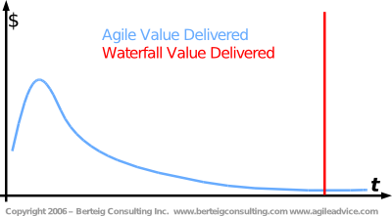
Paradigms: History – Delivery of “value”

Slide 23
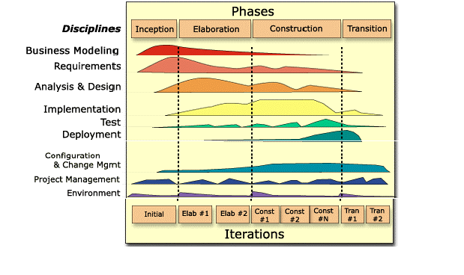
Paradigms: History – Rational Unified Process
Identifies phases of overlapping Disciplines (compare Waterfall)
Identified as a “software engineering process” or a “configurable process framework”
UML tightly interwoven – although UML also used independently of RUP in OO projects

Slide 24
Paradigms: History – Extreme Programming
Extreme Programming (XP) is a system of practices that a community of software developers is evolving to address the problems of quickly delivering quality software, and then evolving it to meet changing business needs. It has already been proven at many companies of all different sizes and industries world wide.
Why ”Extreme”? Taking proven practices to the extreme:
If testing is good, let everybody test all the time
If code reviews are good, review all the time
If design is good, re-factor all the time
If integration testing is good, integrate all the time
If simplicity is good, do the simplest thing that works
If short iterations are good, make them really short

Slide 25
Paradigms: History – Extreme Programming
In a word (well, two words) “Embrace change”
“A light-weight methodology for small-to-medium-sized teams in the face of vague or rapidly changing requirements” Beck, 2000
Basic values: Communication, Simplicity, Feedback, Courage
Core practices:
On-site Customer
Metaphor
Small Releases
Planning Game
Pair Programming
Collective Ownership
Refactoring
Simple Design
Continuous Integration
Coding Standard
40-hour Week
Testing

Slide 26
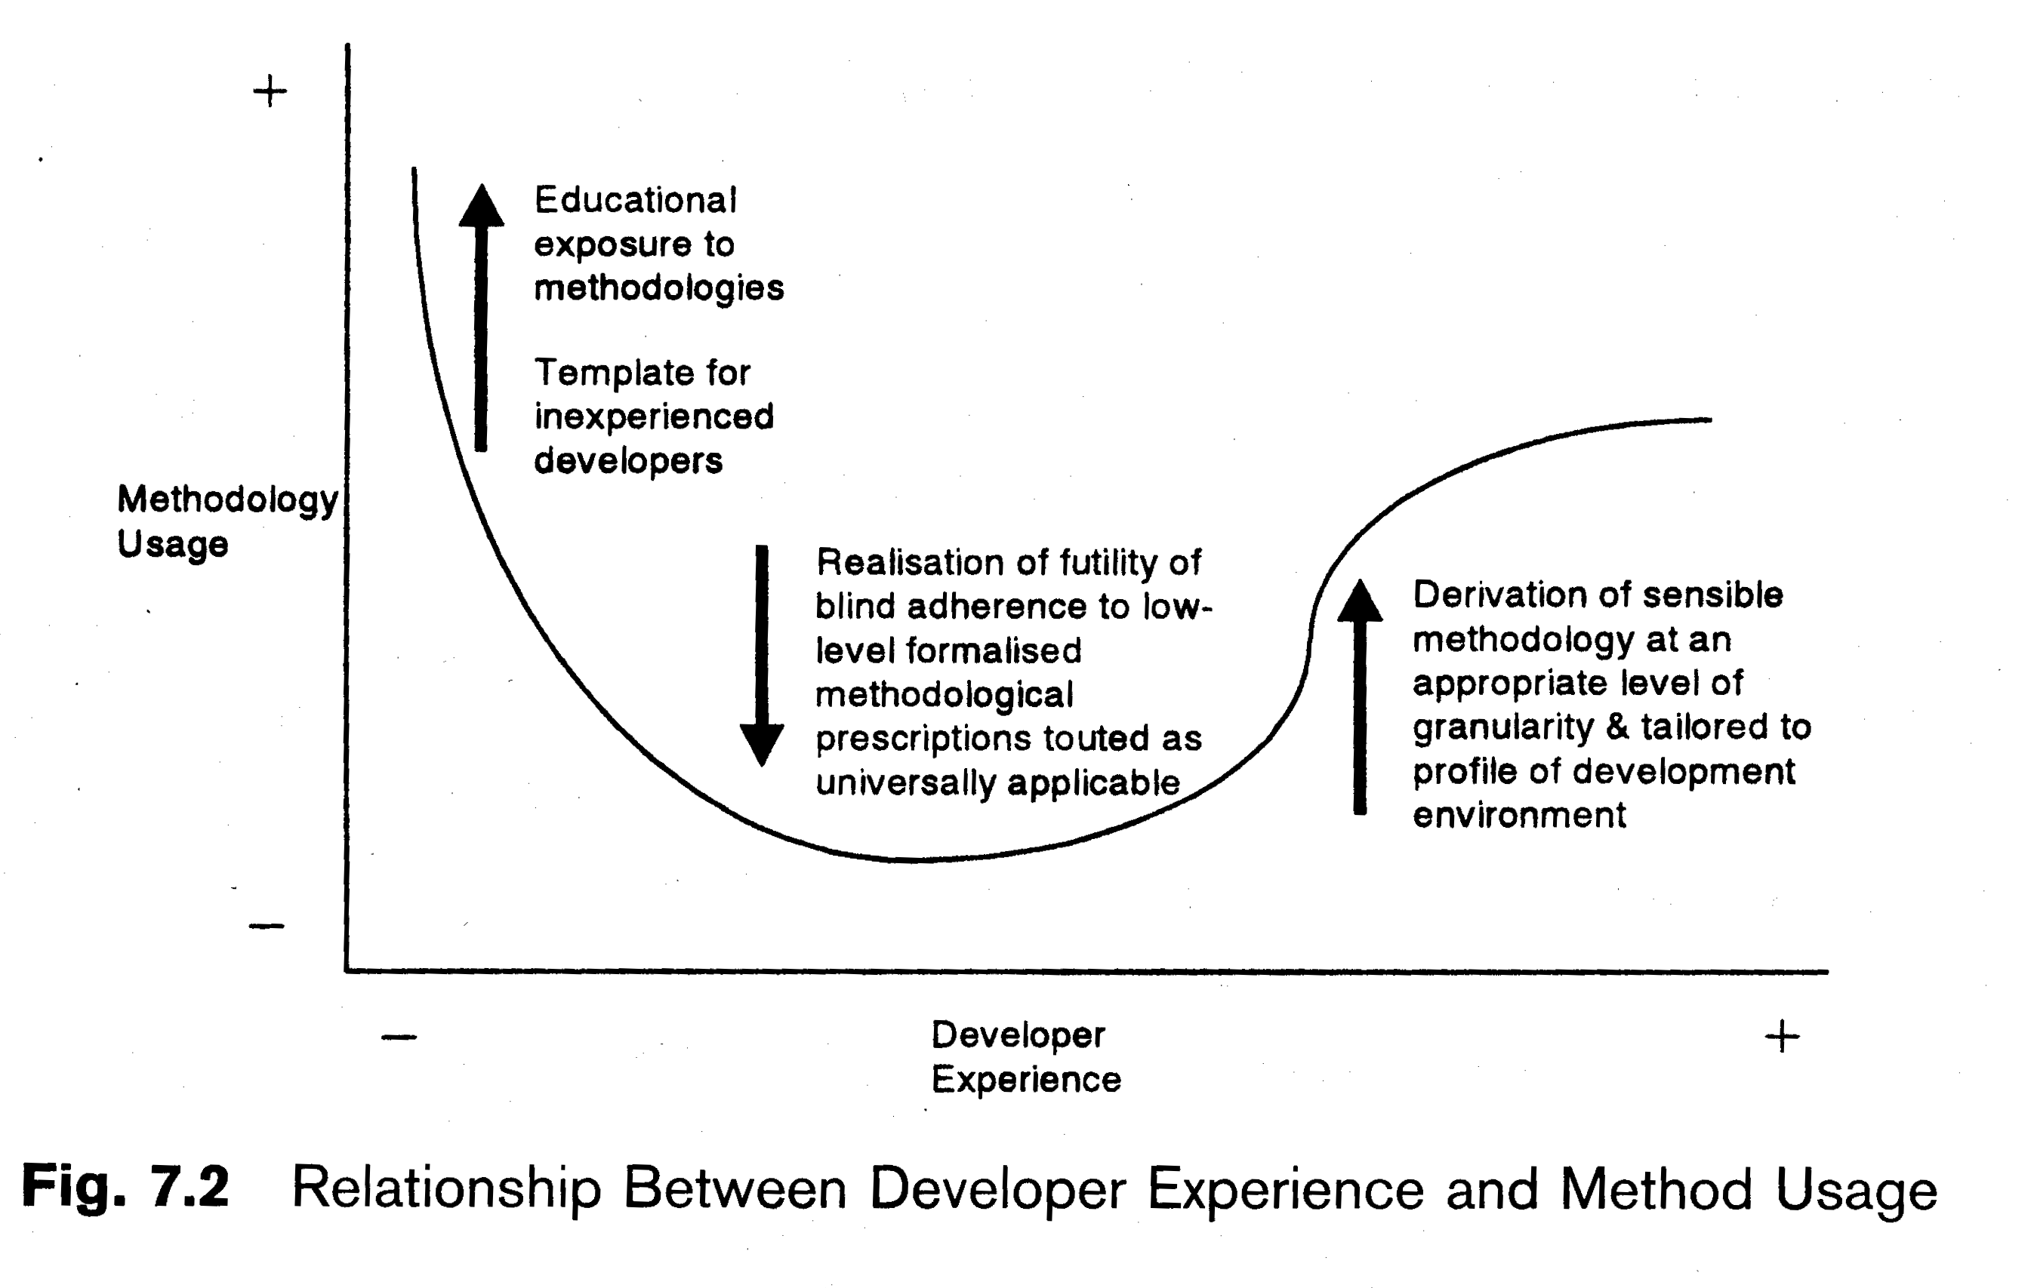
Paradigms: History – Developers & Method

Slide 27
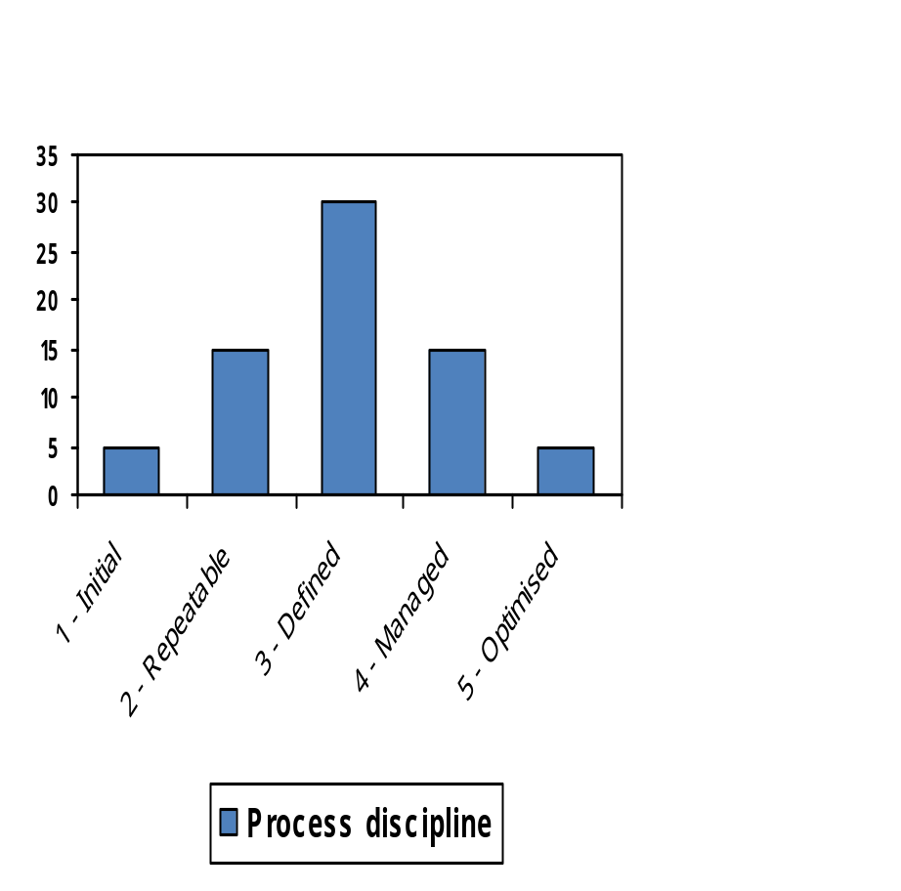
Comparison: Method v. Process Discipline
From 1 – 3 process discipline collectivises:
    individual → team → company
From 3 – 5 process discipline individualises:
    company → team → individual
… which brings us back to “capable people”, who are sufficiently self disciplined that they don’t need much process discipline?

Slide 28
Lecture Outline
Introduction to Software Development Paradigms
Paradigms: A framework and concepts
Paradigms: History and types
Types of Information System Development
Notes:
CS5707 Software Development Paradigms
John Dawson
CS5707 Software Development Paradigms
John Dawson
CS5707 Software Development Paradigms
John Dawson

Slide 29
Types of Information System Development

Slide 30
IS Development: Bespoke Systems
Traditionally, the focus of attention, but now becoming rarer – for economic reasons; being replaced by:
Packages: either acquired separately (COTS) or as an integrated whole (ERP)
Open Source – a new paradigm?
IDE: a new type of bespoke system, but for a restricted domain

Slide 31
IS Development: Packages: COTS
Everyone uses the same – or similar – solutions, leading to reduced costs
Suppliers can afford to devote more resources into developing configurable – and reliable – products
Availability of cheap products overcomes the “our requirements are unique” syndrome
Examples: Operating Systems, Office Software (Microsoft), Accounting Software (SAGE), Manufacturing (small number of specialised suppliers)
For the customer, programming is eliminated, and customisation is (mostly) straightforward

Slide 32
IS Development: IDE / Framework / 4GL
A attempt to make programming easier and more productive
Although tools, can also be viewed as method
Makes it easier to produce “something”, at the price of making it harder to produce “anything”
Some generate code – in the background; in theory, the programmer doesn't need to know, in practice, often does, risking negation of benefits
Many variants / types
Successful niches: Eclipse, UML tools, CASE tools, SAP (also a product), TP monitors (3rd generation), CAD tools etc.

Slide 33
IS Development: Open Source Systems
Licensing: More than “free” source – software must be distributed under same terms – multiple license types
People: Contributors – some employed, some freelance; Testers / Users – no clear distinction
Technology: Repositories, Mailing lists / Forums / Wikis – mostly asynchronous
Hierarchy: Leaders, Committers (write access to code), Developers, Users – often more multi-levelled than that
Evolution: Fork → survival of best (Darwinian)
Organisation: “Do-ocracy” – Do-it-yourself / Meritocracy – but often dominated by “loudest” contributors
Benefits: Faster development & faster bug fixes, higher quality software – effectively multiple code reviews
Can OSS develop better quality software?
Notes:
CS5707 Software Development Paradigms
John Dawson

Slide 34
Next Week
Software Testing
Notes:
CS5707 Software Development Paradigms
John Dawson
CS5707 Software Development Paradigms
John Dawson
CS5707 Software Development Paradigms
John Dawson

Slide 35
Reading
Assessable paper: due week 7
A Taxonomy to Compare SPI Frameworks (2002), Christian Printzell Halvorsen, Reidar Conradi
General reading
B. Fitzgerald, N. Russo and E. Stolterman (2002) Information Systems Development: Method-in-Action, McGraw Hill, chapter 2
Notes:
CS5707 Software Development Paradigms
John Dawson
CS5707 Software Development Paradigms
John Dawson
CS5707 Software Development Paradigms
John Dawson

Slide 36
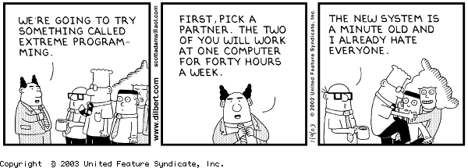
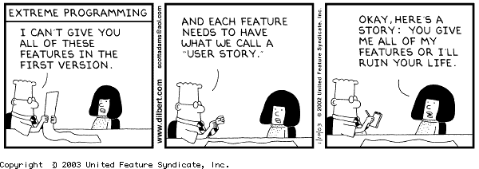
Dilbert on eXtreme Programming

